Slide 1
Sizing a battery
Max Yan
PhD candidate
University of Sheffield
myan5@sheffield.ac.uk

Slide 2







About me
MEng Chemical Engineering (4 year programme)
  Year abroad at University at Buffalo (SUNY)
CDT in Energy Storage and its Applications (PhD)
  http://www.energystorage-cdt.ac.uk/
Supervisor – Prof. Siddharth Patwardhan
  https://www.svplab.com/
Porous silicon anodes for lithium-ion batteries
  Magnesiothermic reduction of silica

Slide 3
Part 1 – Terminology and calculations

Slide 4
Sizing up a battery – basic parameters and calculations
Voltage (V), Current (A)
Parallel and series circuits
Capacity, energy (Ah, Wh)
C-rate (C)

Slide 5



Sizing up a battery – voltage, current, power
Electrical Engineering parameter | Chemical Engineering equivalent parameter
Voltage (V) | Fluid pressure (kPa, psi)
Current (A) | Flowrate (m³/s)
Electrical power (W) | Mechanical, or pump power (W)
$$Voltage∗Current=Power$$
$$Pressure∗Flowrate=Power$$

Slide 6



Sizing up a battery – parallel and series circuits
In series circuit (S), output voltage increases, current stays the same
In parallel circuit (P), output current increases, voltage stays the same
Batteries have maximum safe operating voltage (and current)
  Approx. 3.6V for Li-ion
  1.2 - 1.5V for NiMH
Increase voltage and current by connecting in P and S
V
$V_{Total}=3.6V$
1.2V
1.2V
1.2V
0.3A
$V_{Total}=1.2V$
A
V
1.2V
0.3A
0.1A
0.1A
0.1A
$I_{Total}=0.3A$
0.3A

Slide 7
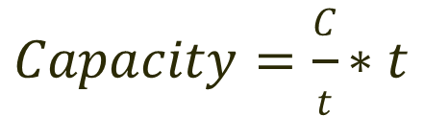

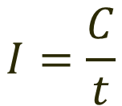

Sizing up a battery - capacity
$$I=\frac{C}{t}$$
C = Charge, in coulombs
t = time, in seconds
I = Current, in coulombs/s (amps)
Capacity, measured in amp-hours (Ah)
$$Capacity=I∗t$$
$$Capacity=\frac{C}{t}∗t$$
$$Capacity=C$$
1 Ah capacity can supply a current of 1 A for 1 hour

Slide 8
Capacity vs energy
Elevation
Ground level
Voltage
Capacity
Negative voltage
No usable energy
Positive voltage
Usable energy

Slide 9




Sizing up a battery - energy
V = Voltage (V)
I = Current (A)
Cap = Capacity (Ah)
t = time (s)
P = Power (W)
E = Energy content (Wh)
Hence, energy content = capacity x voltage
Units of energy content in a battery given in watt-hours
$$P=\frac{E}{t}$$
$$E=P∗t$$
$$Power=Voltage ∗Current$$
$$E=V∗I∗t$$
Capacity

Slide 10
Sizing up a battery – C-rate
Rate of charging/discharging of a battery
Quoted as multiple of capacity of battery
For example: taking a 3 Ah battery
C-rate | Current (A) | Time taken (hrs)
1C | 3 | 1
0.5C | 1.5 | 2
0.1C | 0.3 | 10
0.01C | 0.03 | 100

Slide 11
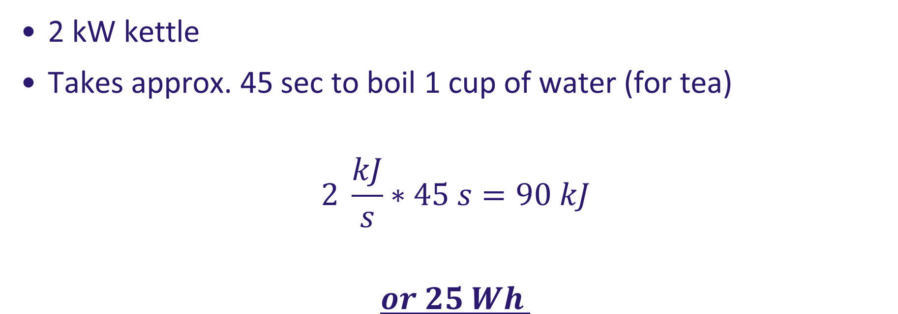
Problem 1 – Boiling the kettle
2 kW kettle
Takes approx. 45 sec to boil 1 cup of water (for tea)
$$2 \frac{kJ}{s}∗45 s=90 kJ$$
$$or 25 Wh$$

Slide 12



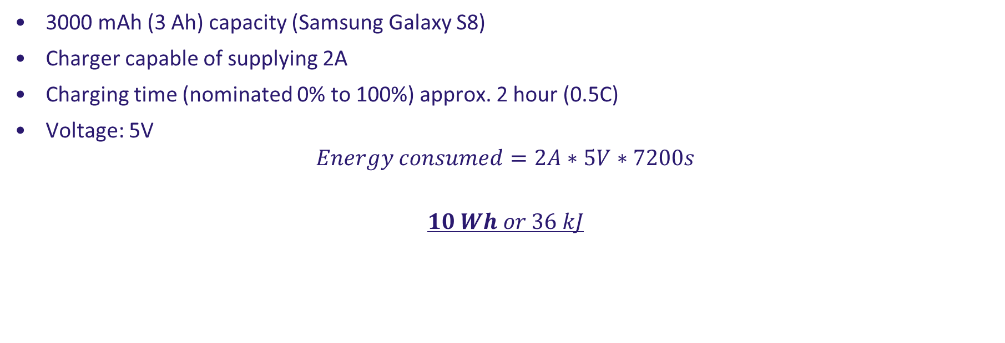
Problem 2 - charging your phone
3000 mAh (3 Ah) capacity (Samsung Galaxy S8)
Charger capable of supplying 2A
Charging time (nominated 0% to 100%) approx. 2 hour (0.5C)
Voltage: 5V
$$Energy consumed=2A∗5V∗7200s$$
$$10 Wh or 36 kJ$$

Slide 13
Comparing energy storage devices
Luo, X., Wang, J., Dooner, M., Clarke, J., 2015. Appl. Energy.

Slide 14
Comparing batteries
Tarascon, J.-M., Armand, M., 2001. Nature.

Slide 15
Part 2 – Common battery types

Slide 16
Useful notes
Electrons are negative – flow of electrons is from –ve electrode (anode) to +ve electrode (cathode)
In electronics, current flows from positive to negative – this is convention
In batteries, when you charge, you store energy (and electrons) in the anode
In this section, all equations are written so that forward reactions are spontaneous

Slide 17
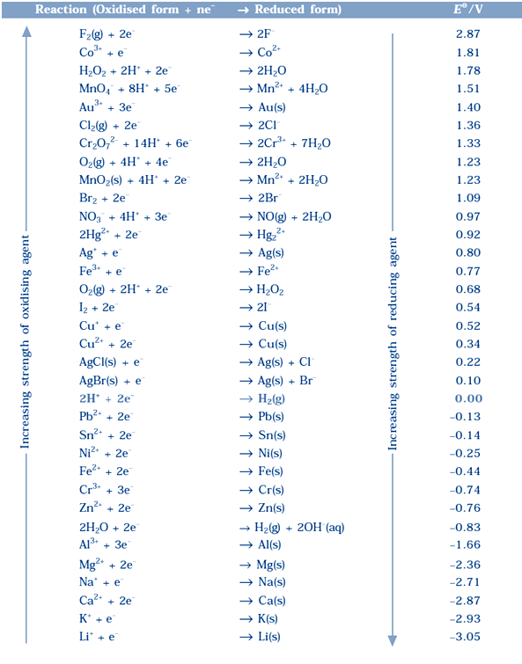
Useful notes - refresher
Reduction reactions
Spontaneous reactions determined from standard electrode potentials
The more positive the potential, the more likely it will (spontaneously) accept electrons

Slide 18
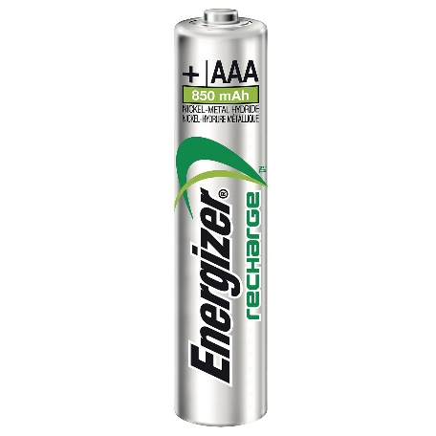
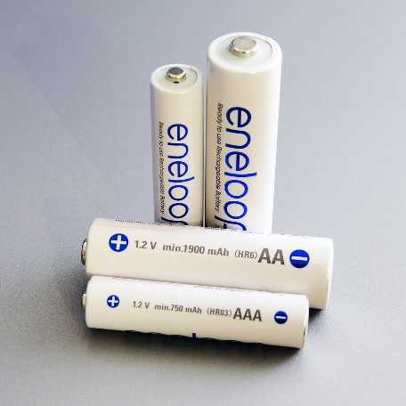
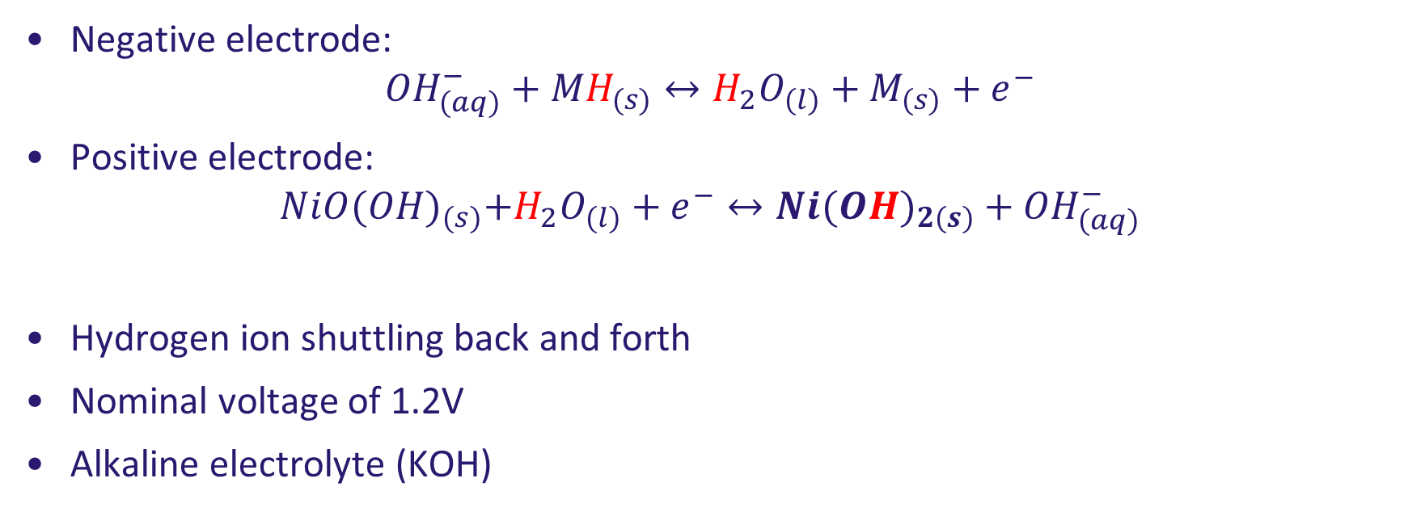
Nickel metal hydride
Negative electrode:
$${OH}_{(aq)}^{−}+{MH}_{(s)}↔H_{2}O_{(l)}+M_{(s)}+e^{−}$$
Positive electrode:
$$NiO{(OH)}_{(s)}+H_{2}O_{(l)}+e^{−}↔{Ni(OH)}_{2(s)}+{OH}_{(aq)}^{−}$$
Hydrogen ion shuttling back and forth
Nominal voltage of 1.2V
Alkaline electrolyte (KOH)
Notes:
La, Nd, Ce, Pr. Ni, Co, Mn, Al.
Ti, V. Zr, Ni, Cr, Co, Fe, Mn

Slide 19
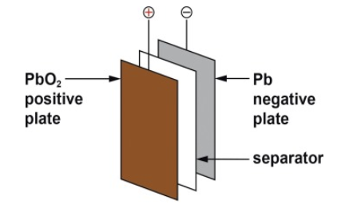
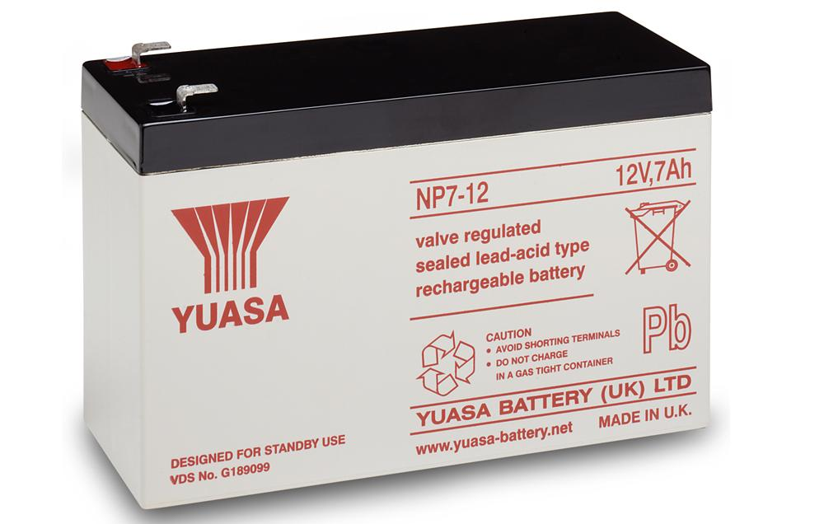
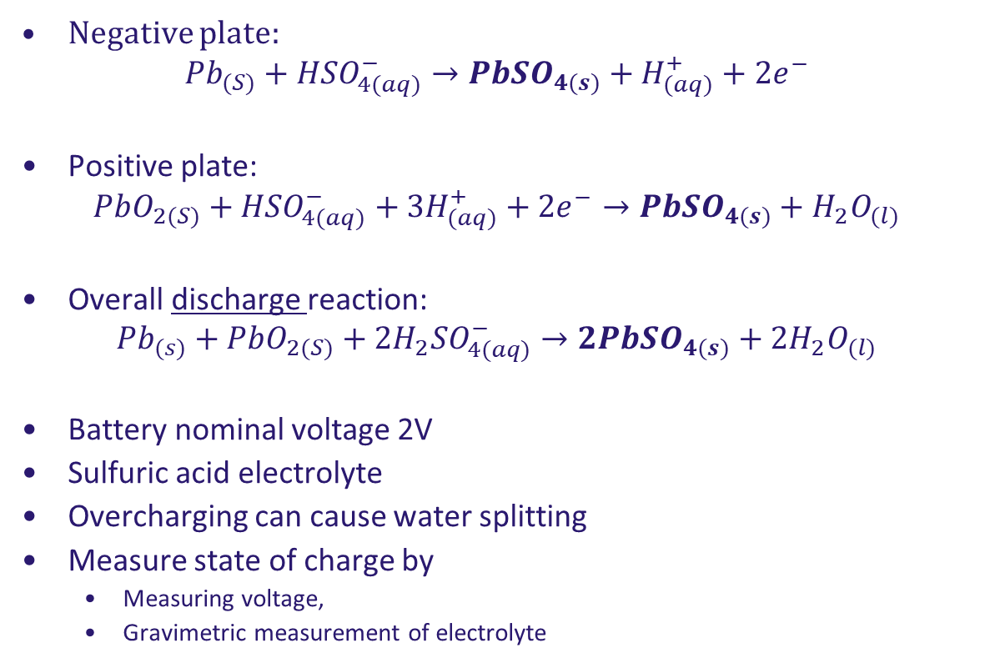
Lead acid
Negative plate:
$${Pb}_{(S)}+{HSO}_{4(aq)}^{−}→{PbSO}_{4(s)}+H_{(aq)}^{+}+{2e}^{−}$$
Positive plate:
$${PbO}_{2(S)}+{HSO}_{4(aq)}^{−}+{3H}_{(aq)}^{+}+{2e}^{−}→{PbSO}_{4(s)}+H_{2}O_{(l)}$$
Overall discharge reaction:
$${Pb}_{(s)}+{PbO}_{2(S)}+2{H_{2}SO}_{4(aq)}^{−}→{2PbSO}_{4(s)}+{2H}_{2}O_{(l)}$$
Battery nominal voltage 2V
Sulfuric acid electrolyte
Overcharging can cause water splitting
Measure state of charge by
  Measuring voltage,
  Gravimetric measurement of electrolyte
May, G.J., Davidson, A., Monahov, B., 2018. J. Energy Storage 15, 145–157.

Slide 20
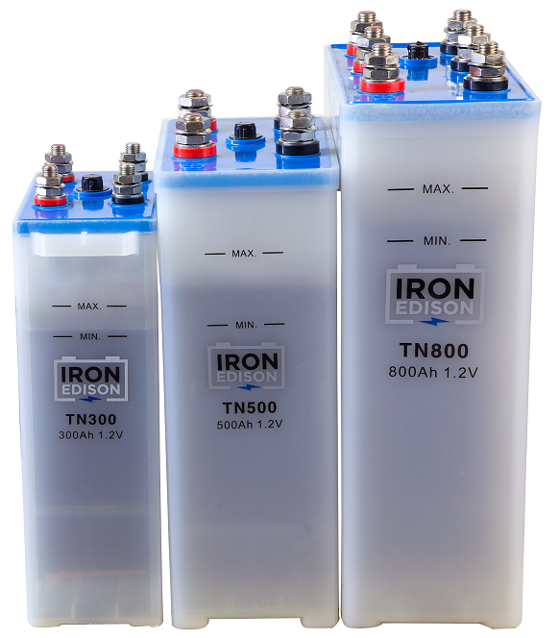
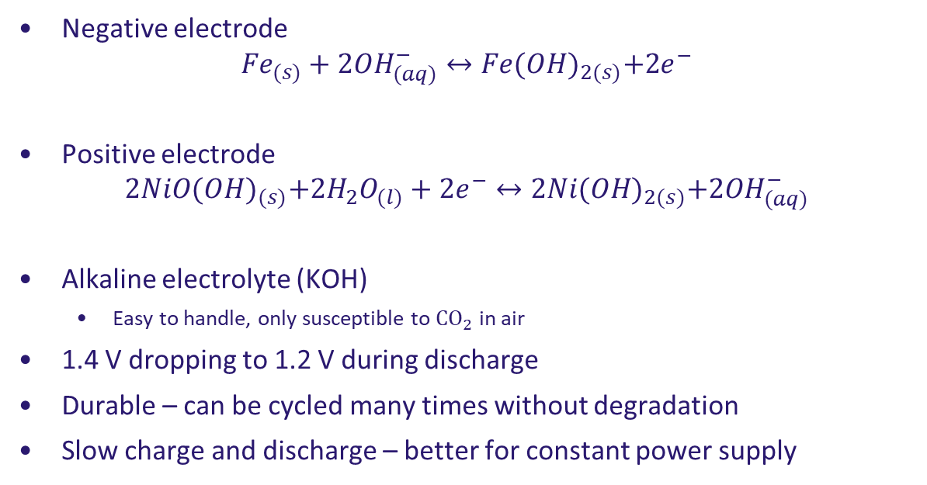
Edison battery
Negative electrode
$${Fe}_{(s)}+2{OH}_{(aq)}^{−}↔Fe{(OH)}_{2(s)}+{2e}^{−}$$
Positive electrode
$$2NiO{(OH)}_{(s)}+2H_{2}O_{(l)}+2e^{−}↔2Ni{(OH)}_{2(s)}+2{OH}_{(aq)}^{−}$$
Alkaline electrolyte (KOH)
  Easy to handle, only susceptible to ${CO}_{2}$ in air
1.4 V dropping to 1.2 V during discharge
Durable – can be cycled many times without degradation
Slow charge and discharge – better for constant power supply

Slide 21
Part 3 – Lithium-ion battery

Slide 22
Lithium-ion battery
Intercalation reactions occur
Lithium-ions move into material lattices
Lithium ions shuttle back and forth
Graphite stores lithium when fully charged
Cathode accepts lithium during discharge
Lithium highly reactive
  Requires absence of water or oxygen during manufacture and operation

Slide 23
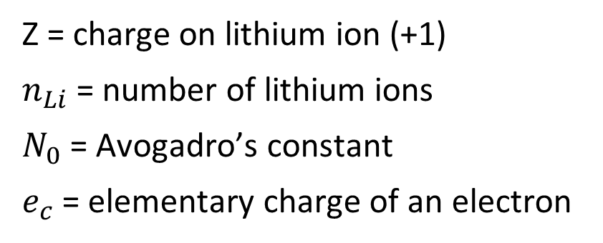


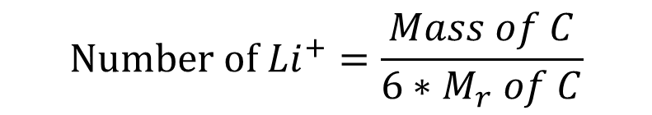
Calculating theoretical specific capacity (mAh/g)
$${Li}^{+}+6C+e^{−}→LiC_{6}$$
$$Number of {Li}^{+}=\frac{Mass of C}{6∗M_{r} of C}$$
$$Total capacity=z∗n_{Li}∗N_{0}∗e_{c}$$
Z = charge on lithium ion (+1)
$n_{Li}$ = number of lithium ions
$N_{0}$ = Avogadro’s constant
$e_{c}$ = elementary charge of an electron
Graphite theoretical specific capacity:
371 mAh/g

Slide 24

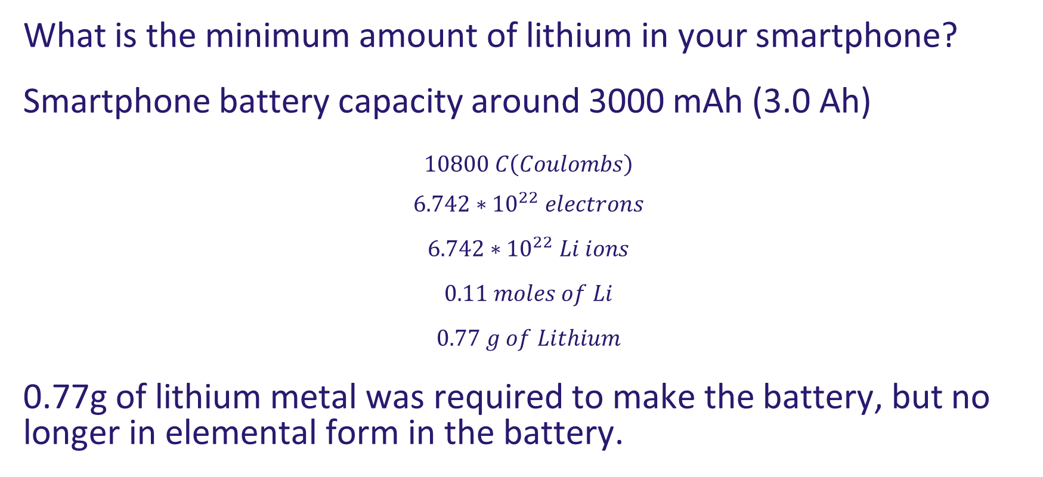


Lithium ion battery calculations
What is the minimum amount of lithium in your smartphone?
Smartphone battery capacity around 3000 mAh (3.0 Ah)
$$10800 C\left(Coulombs\right)$$
$$6.742∗{10}^{22} electrons$$
$$6.742∗{10}^{22} Li ions$$
$$0.11 moles of Li$$
$$0.77 g of Lithium$$
0.77g of lithium metal was required to make the battery, but no longer in elemental form in the battery.
$1 electron=1.602∗{10}^{−19}C$
$$Li→{Li}^{+}+e^{−}$$
$$A_{v}=6.022∗{10}^{23}$$

Slide 25
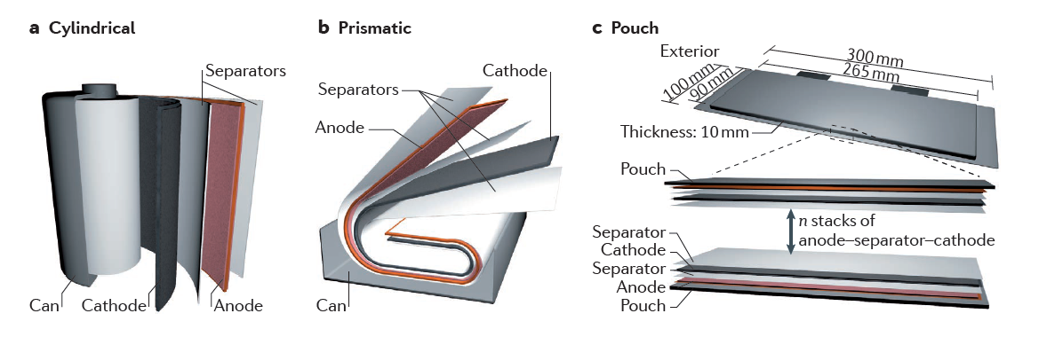
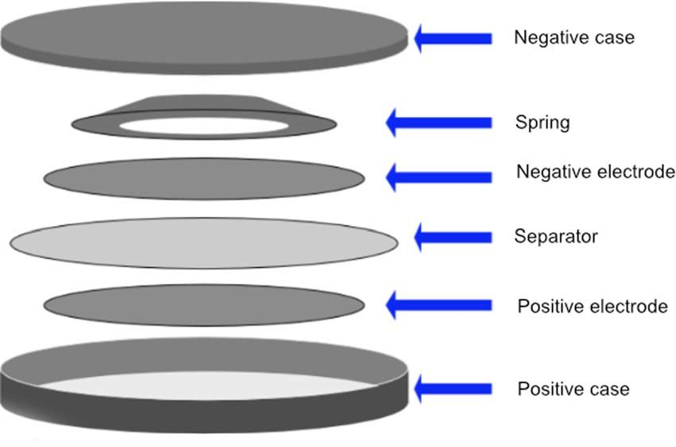
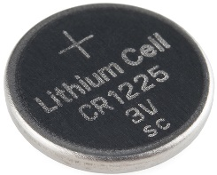
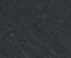
Cell configurations
Cylindrical cells are most efficient
Can be wound with high tension
Commonly made into 18650 (18 mm dia, 65 mm height)
AA batteries are 14500, not usually lithium ion

Slide 26
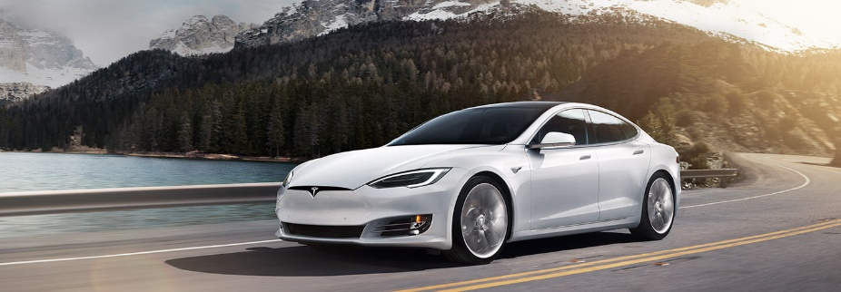
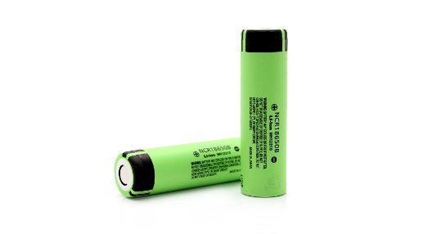

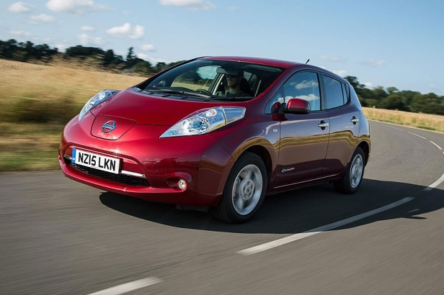
Lithium ion batteries for EVs
Tesla Model S 85
  85 kWh battery pack
  18650 cell type
  6 cells per module, 16 modules
  74 in parallel
  7104 cells total
  360V
Nissan Leaf
  24 kWh battery
  Pouch-cell type
  4 cells per module, 48 modules
  32.5 Ah per cell
  192 pouch cells total
1 module
1 cell
1 module
1 cell

Slide 27
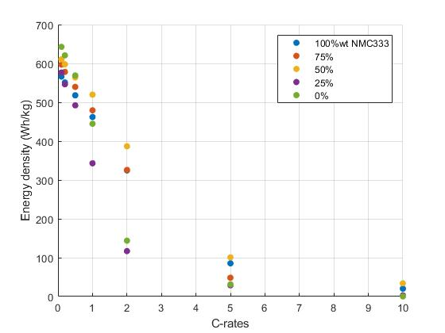
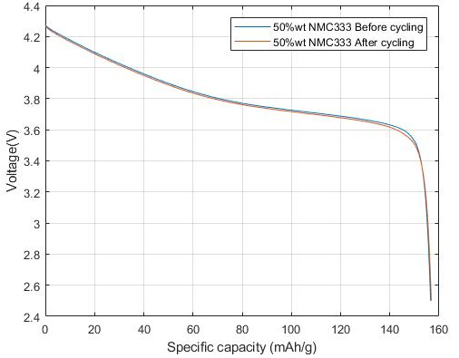
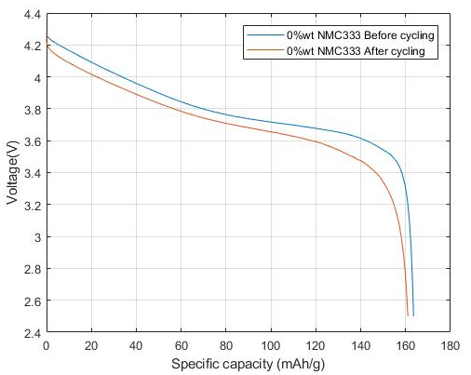
Discharge characteristics
Capacity (and energy stored) is dependent on C-rate
Battery degrades after cycling
Discharge at 0.1C (bottom left)
6 charge cycles (bottom right)

Slide 28
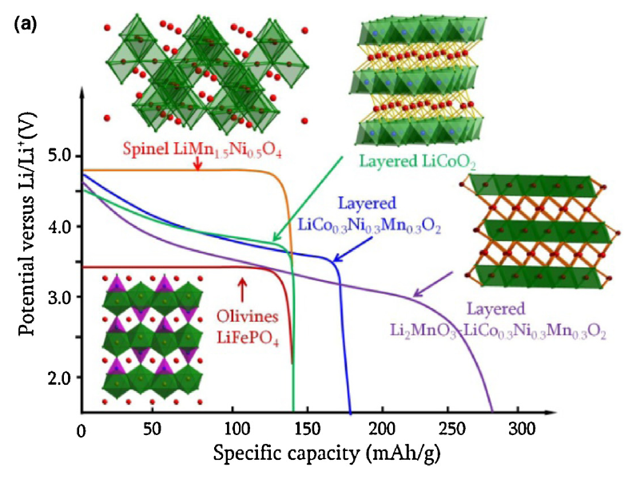
Discharge characteristics
Discharge curve shape is dependent on cathode material
Spinel and olivine
  Have robust structure
  Do not distort when intercalating
Layered structures
  Distort during intercalation
  Energy is lost when lithium forces into structure
  Sloping voltage profile
Liu, C., Neale, Z.G., Cao, G., 2016. Mater. Today.

Slide 29
Part 4 – Silicon anodes

Slide 30
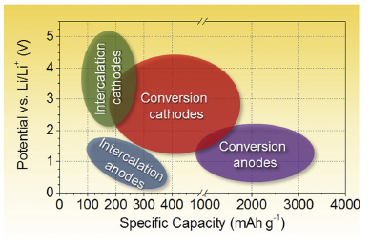
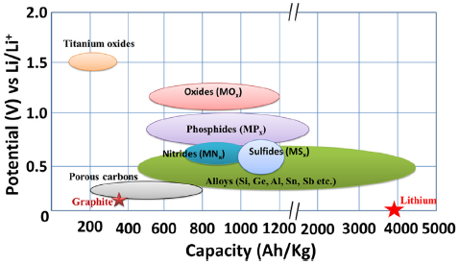
Anode materials

Slide 31
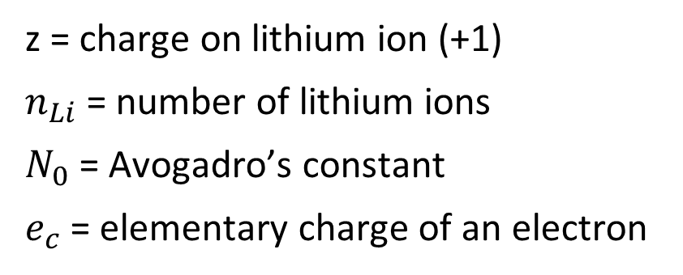

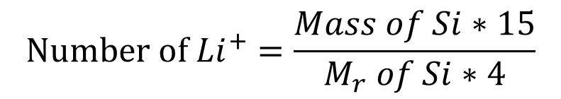
Calculating theoretical specific capacity (mAh/g)
$${15Li}^{+}+4Si+e^{−}→{Li}_{15}{Si}_{4}$$
$$Number of {Li}^{+}=\frac{Mass of Si∗15}{M_{r} of Si∗4}$$
$$Total capacity=z∗n_{Li}∗N_{0}∗e_{c}$$
z = charge on lithium ion (+1)
$n_{Li}$ = number of lithium ions
$N_{0}$ = Avogadro’s constant
$e_{c}$ = elementary charge of an electron
Silicon theoretical specific capacity:
3571 mAh/g
Graphite = 371 mAh/g

Slide 32
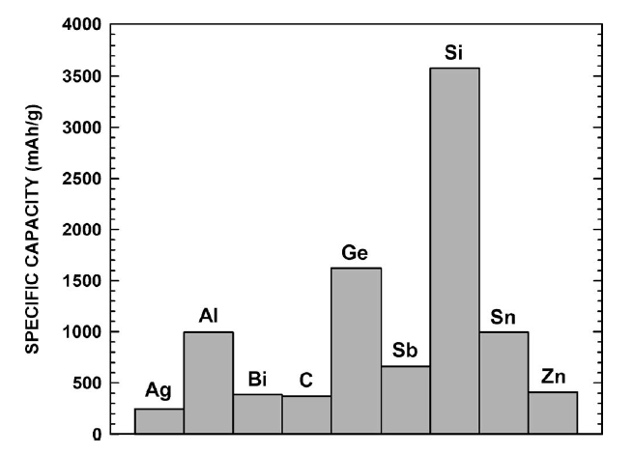
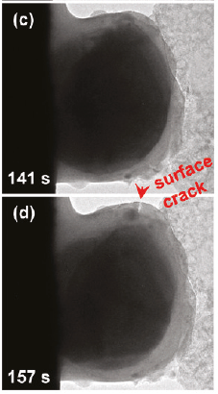
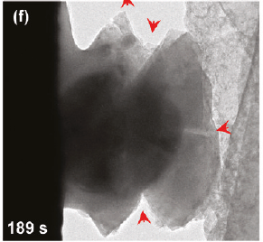
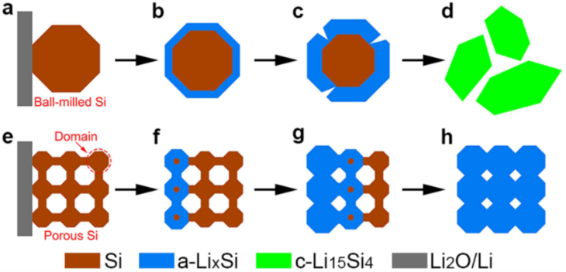
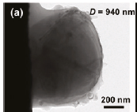
Silicon
Very high capacity
Low cyclability
Needs to be porous

Slide 33
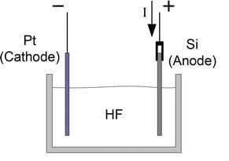
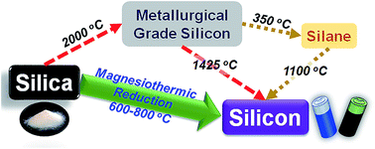
Making silicon
Non-porous: Carbothermal reduction
Porous: electrochemical etching of Si wafer
(1) J. Entwistle, A. Rennie and S. Patwardhan, J. Mater. Chem. A, 2018.
(2) Karbassian, F. Porous Silicon. In Porosity - Process, Technologies and Applications; 2018.

Slide 34
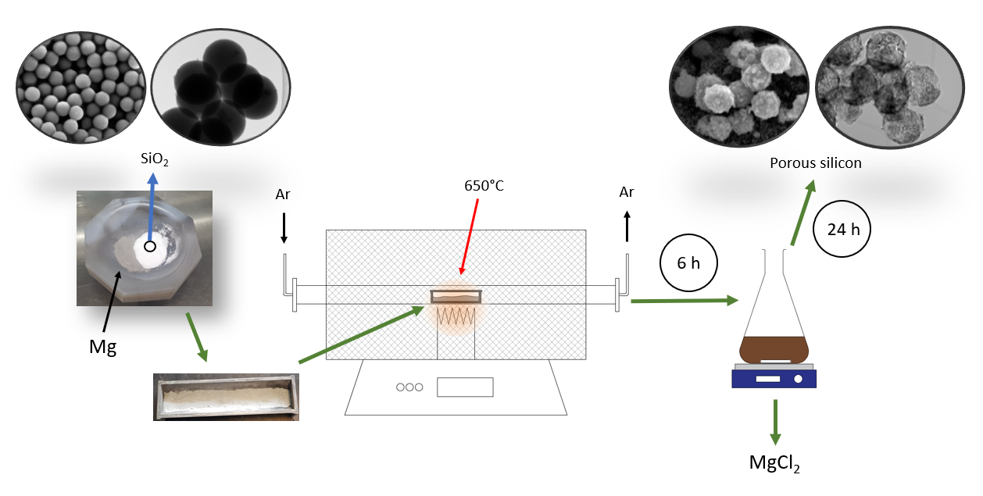
Magnesiothermic reduction (MgTR)

Slide 35
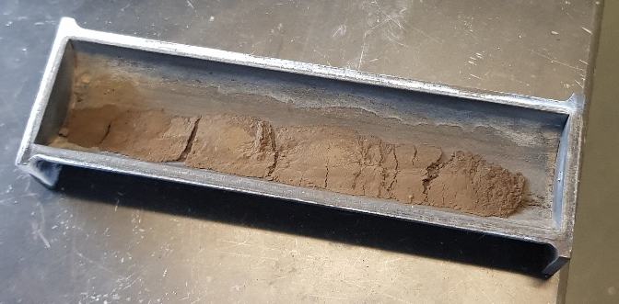
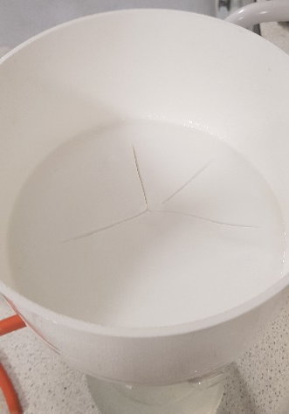
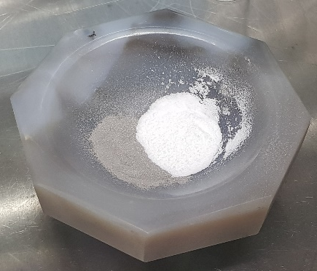
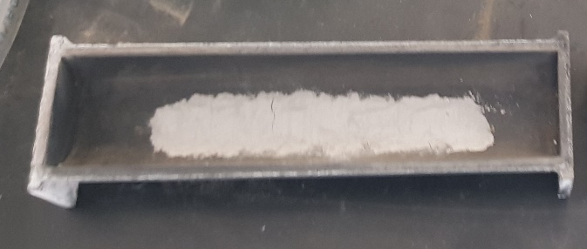


Magnesiothermic reduction
$$Si,{SiO}_{2}MgO, {Mg}_{2}Si$$
$$SiO_{2}, dried$$
Heat at 650ºC, 6 hours
Grind
Mg

Slide 36

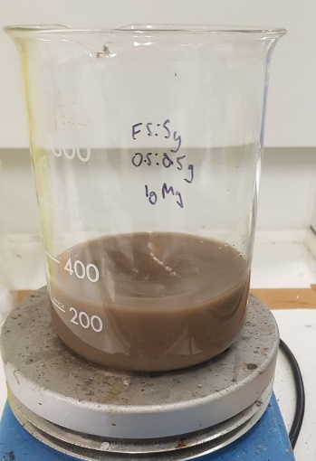
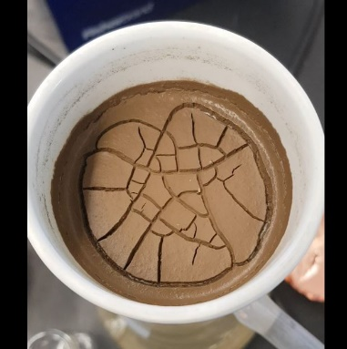


Acid washing
Add HCl
Filter
$$Si,{SiO}_{2}MgO, {Mg}_{2}Si$$
$$Si,{SiO}_{2}$$

Slide 37
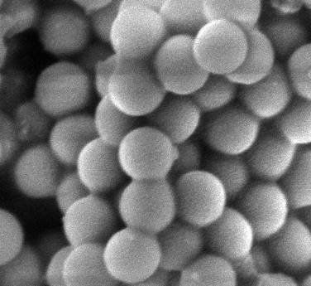
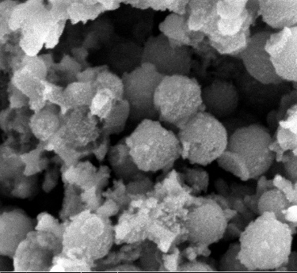

Drawbacks of MgTR
Sintering, loss of surface area
Presently not scalable
Needs improvement in sustainability
Scale bars: 1 μm

Slide 38
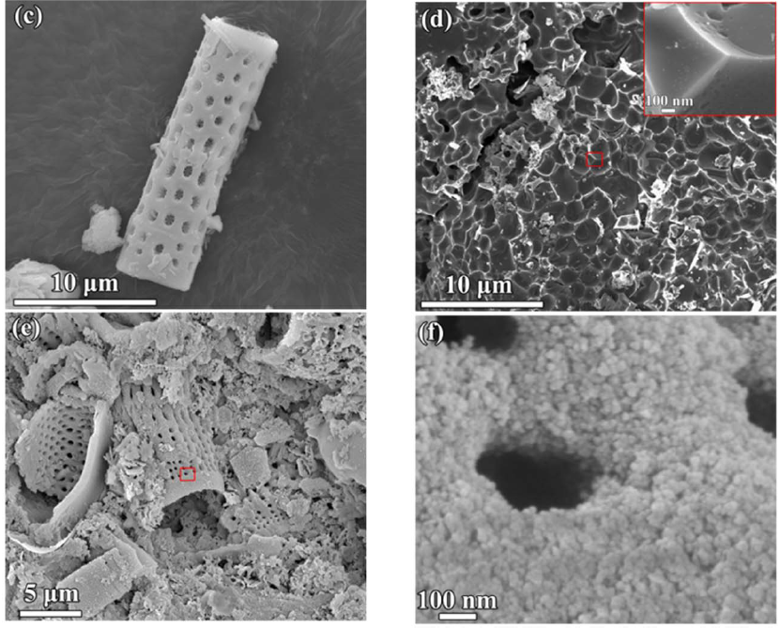
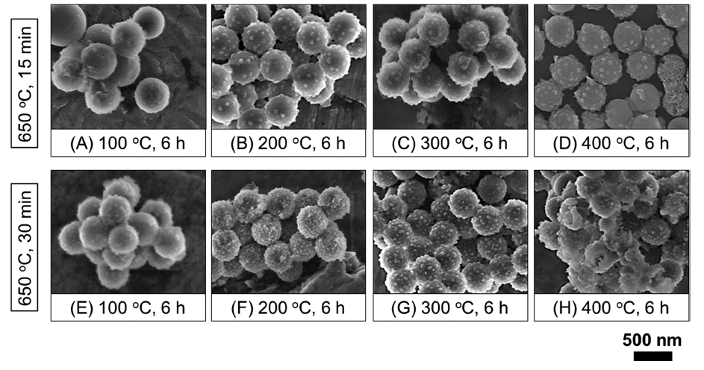

Thermal control
Without NaCl
Low ramp rates
Low temperatures
Salt – thermal sink
Two-step reduction
With NaCl
W. Luo, X. Wang, C. Meyers, N. Wannenmacher, W. Sirisaksoontorn, M. M. Lerner and X. Ji, Sci. Rep., 2013.
S. A. Martell, Y. Lai, E. Traver, J. MacInnis, D. D. Richards, S. MacQuarrie and M. Dasog, ACS Appl. Nano Mater., 2019.

Slide 39


Eutectic reduction
Reduction proceeds at 450ºC
Mg-Al eutectic is formed at 650ºC

Slide 40



Stöber synthesis
Scale bar: 2 μm
Scale bar: 500 nm
Scale bar: 20 nm
500 ± 17 nm
75 ± 8 nm
20 ± 2 nm

Slide 41





MgTR – 500 nm
450ºC
550ºC
650ºC
750ºC
Scale bar: 1 μm

Slide 42


MgTR – 20 nm
Scale bar: 10 nm
Stöber silica (20nm) reduces at 450ºC

Slide 43


MgTR – yields (wt% Si)
Stöber silica
Fumed silica
Fumed and Stöber
Fumed silica (7 nm) reduces at 380ºC

Slide 44
Coin cell electrode preparation
Current collector
Cathode
Anode
Binder
Conductive additive
Separator
Active material

Slide 45




Making the electrode
Mix with carbon, water and binder
$$Si,{SiO}_{2}$$
$$Si,{SiO}_{2}, H_{2}O, Carbon, CMC$$

Slide 46

Drawdown variables
Binder content

Slide 47



Drawdown variables
Water content
Binder content
Drawdown thickness
Drying schedule

Slide 48
Preliminary cell data
Poor initial capacity
Poor cyclability

Slide 49

Ideal drawdown
Smooth (consistent thickness)
No aggregates ‘dragging’ across foil

Slide 50


Coin cell assembly
Punched electrode
2016 Coin cell

Slide 51
Cell data
Low wt% silicon are not electronically connected
Degradation seen in higher wt% silicon
Consumption of active material during SEI formation
49 wt% Si
58 wt% Si
34 wt% Si
32 wt% Si

Slide 52




BFD, reaction stoichiometry
Desirable reaction:
$$2{Mg}_{(s)}+SiO_{2(s)}→2{MgO}_{(s)}+{Si}_{(s)}$$
Dissolution reactions:
$${Mg}_{(s)}+{2HCl}_{(aq)}→2{MgCl}_{2(aq)}+H_{2(g)}$$
$${MgO}_{(s)}+{2HCl}_{(aq)}→{MgCl}_{2(aq)}+H_{2}O_{(l)}$$
$${Mg}_{2}{Si}_{(s)}+{4HCl}_{(aq)}→Mg{Cl}_{2(aq)}+{SiH}_{4(g)}$$
$${SiH}_{4(g)}+{2O}_{2(g)}→{SiO}_{2(s)}+{2H}_{2}O_{(l)}$$
Parasitic reaction:
$$2{Mg}_{(s)}+{Si}_{(s)}→2{Mg}_{2}{Si}_{(s)}$$

Slide 53
Process handles (variables)
5
3,4
1
2
Reactant molar ratios
Degree of mixing
Size of mixture (reaction mass)
Heating rate
Process times

Slide 54
Measurable outputs
Experimental
  Yield
  Properties
  Performance
Modelling
  Operational cost
  Capital cost
  Payback time

Slide 55




Conversion, selectivity, yield
$$C+\frac{1}{2}O_{2}→CO$$
$$C+O_{2}→{CO}_{2}$$
$$Conversion=\frac{Total moles C reacted}{Total starting moles of C }$$
$$Selectivity=\frac{moles CO_{2}}{Total moles C reacted}$$
Conversion x Selectivity = Yield

Slide 56
Chem Eng approach to Chemistry
Quantify the process
Identify biggest bottlenecks at process level (Chem Eng)
Remove bottlenecks using innovations at molecular level (Chemistry)

Slide 57



Acknowledgements:

